Slide 1

Security camera with motion detection alarm
By :- Ayush Mehta

Slide 2
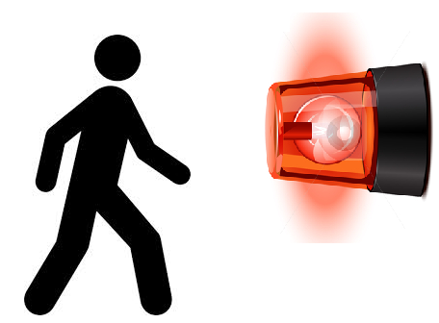
Introduction
The security camera will detect motion of a person and will sound an alarm as the motion is detected.
Using OpenCV we will take input from a webcam and then finding difference between image frames will help us in detecting motion.
To perform this task, some basic knowledge of OpenCV is needed.

Slide 3
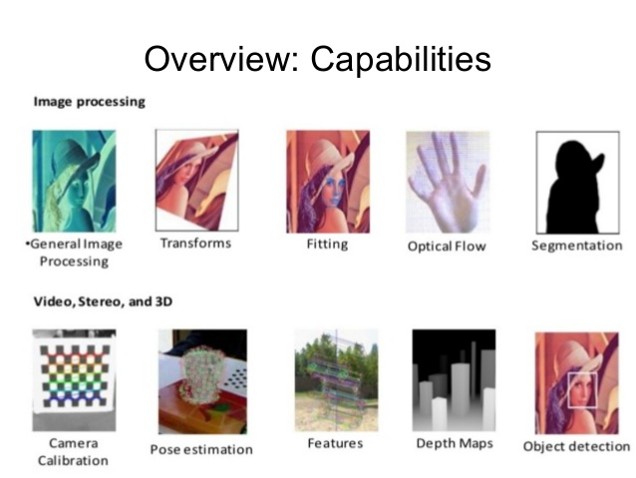
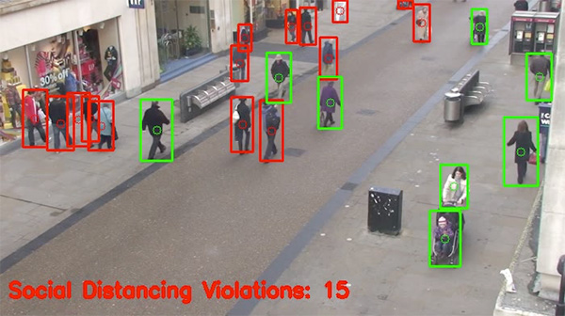
OpenCV
OpenCV is a library of programming functions mainly aimed at real-time computer vision.
Originally developed by Intel, it was later supported by Willow Garage then Itseez.

Slide 4
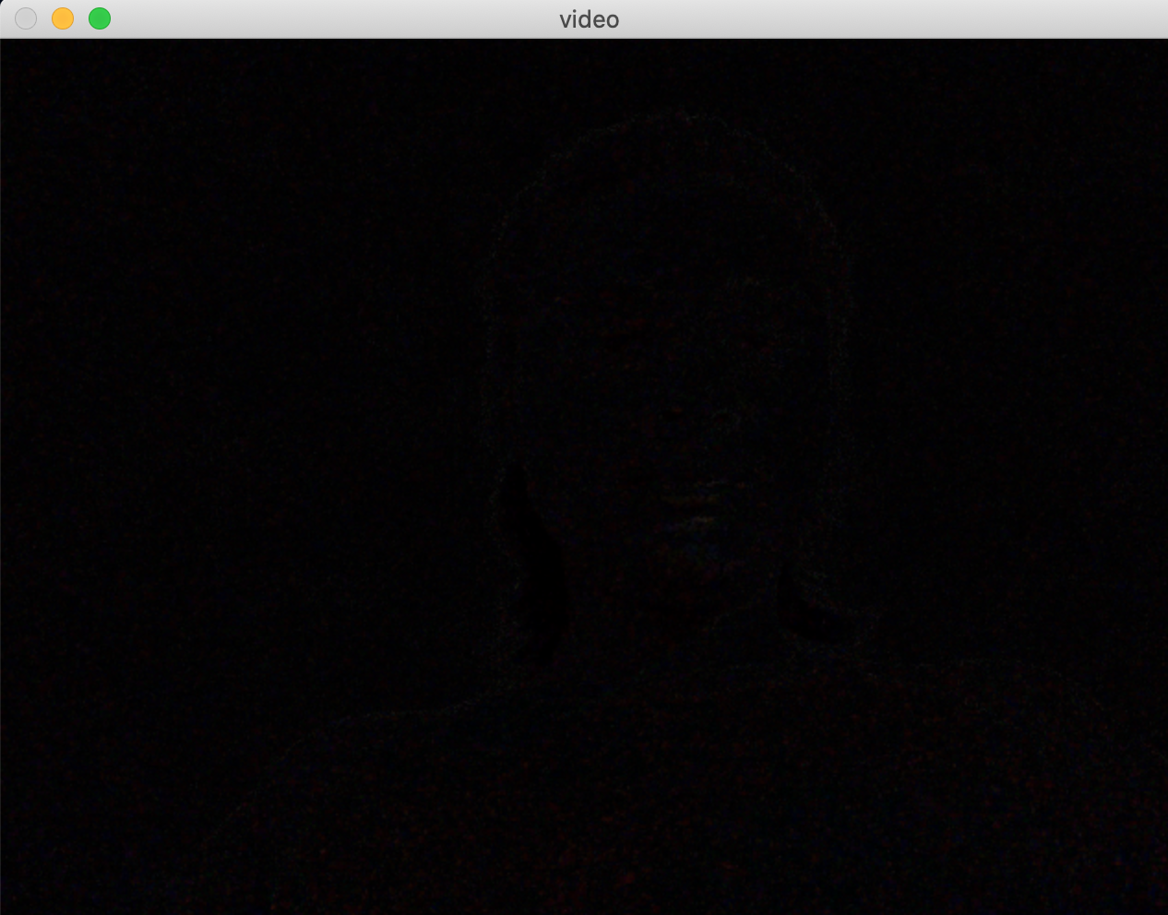
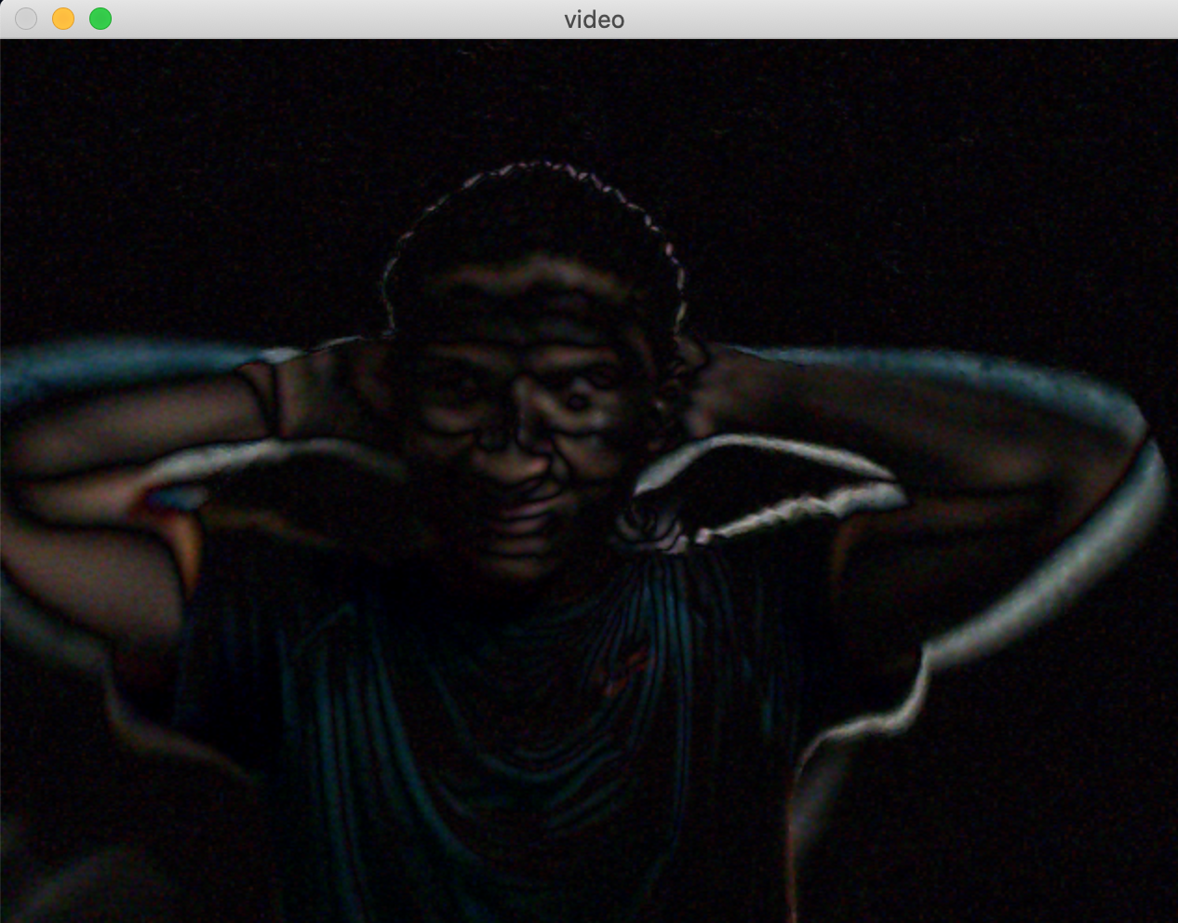
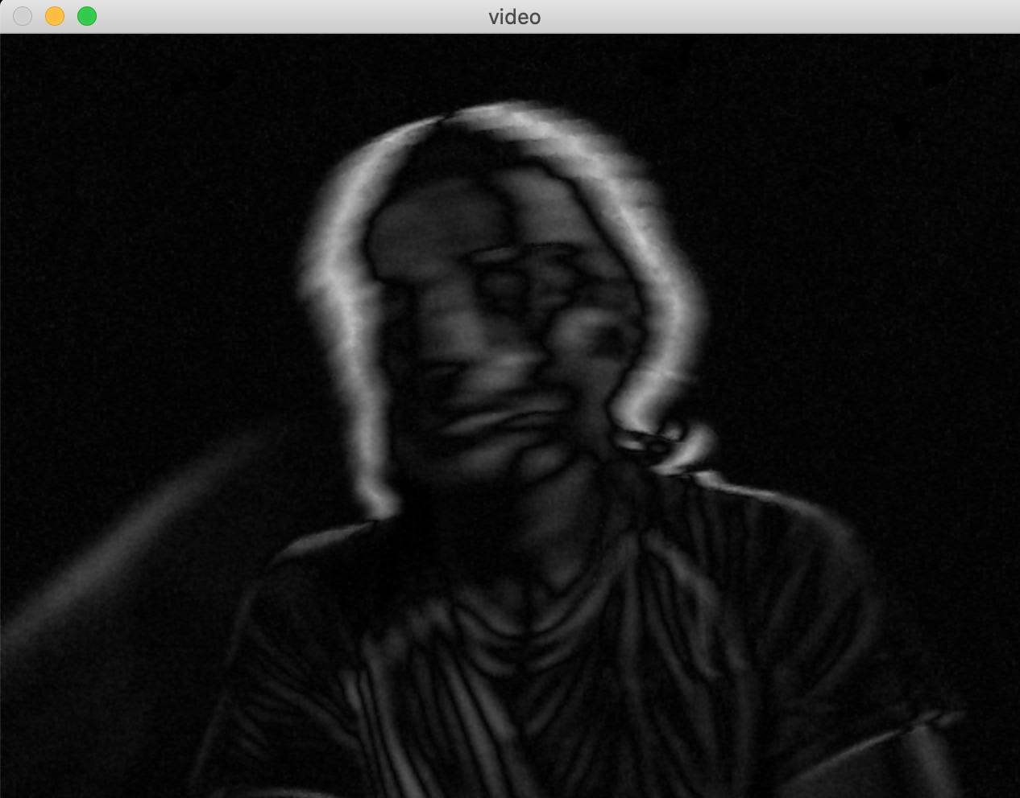
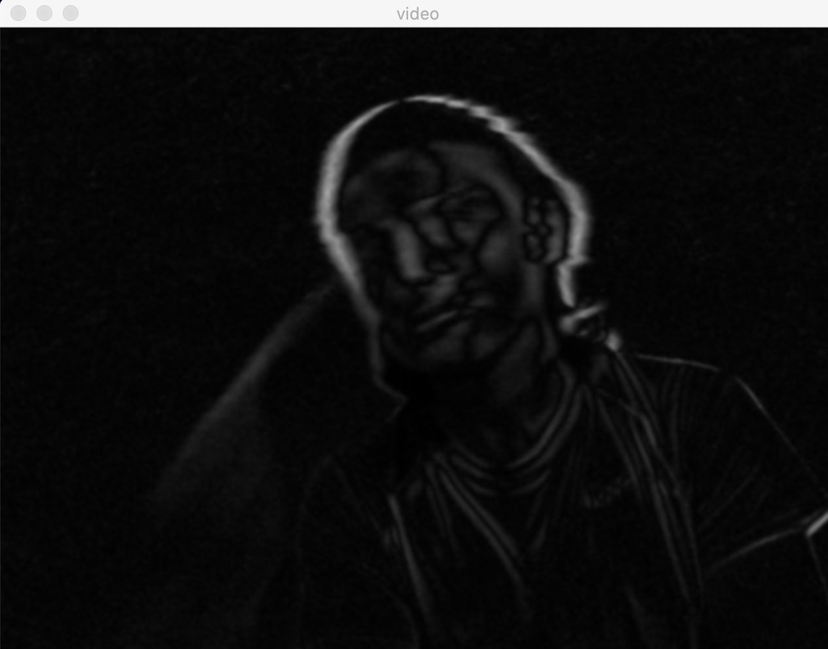
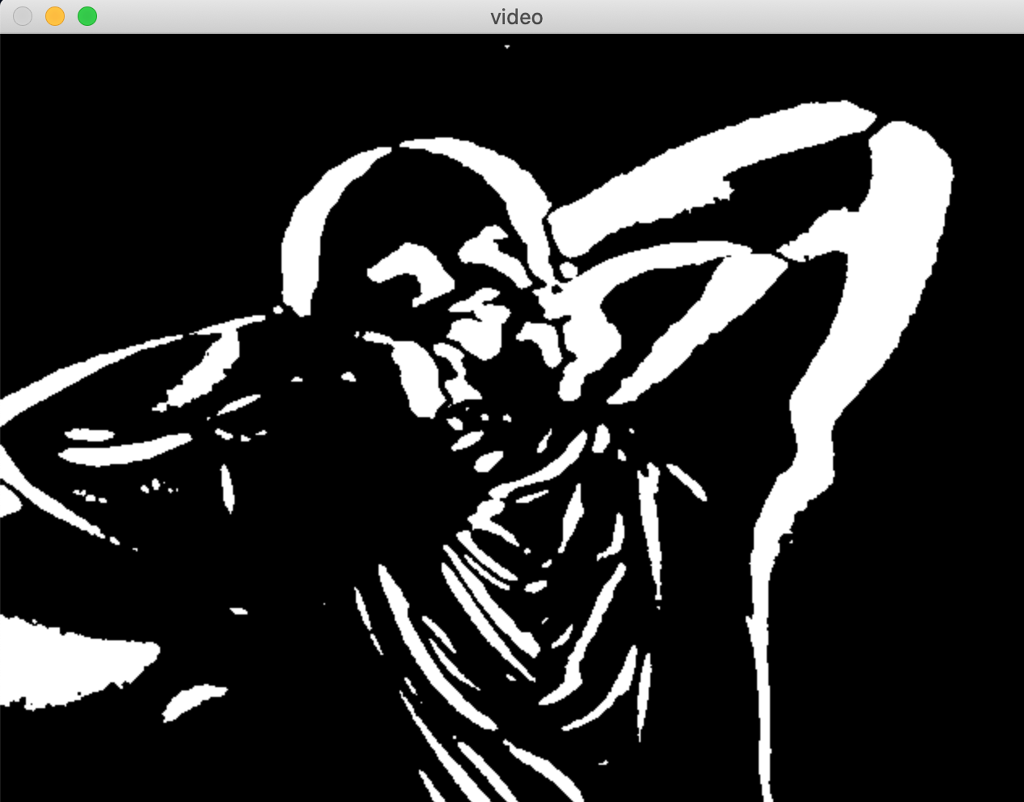
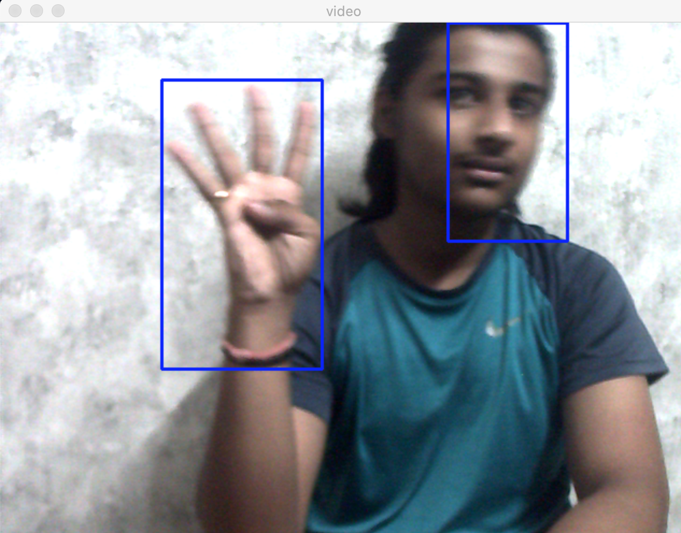
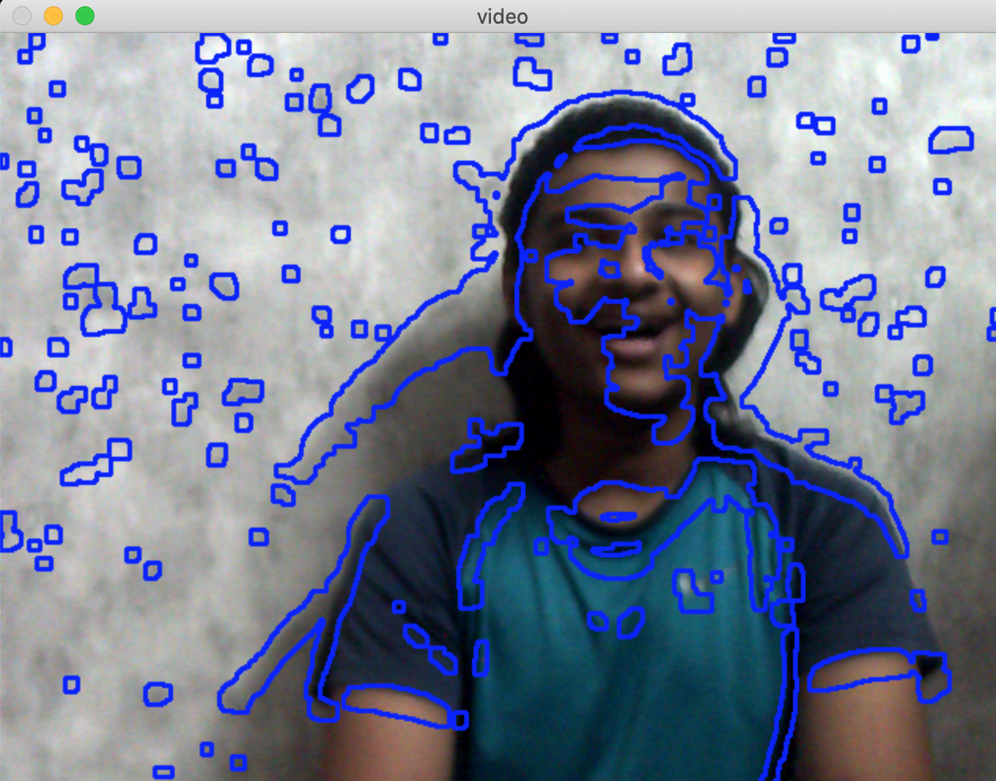
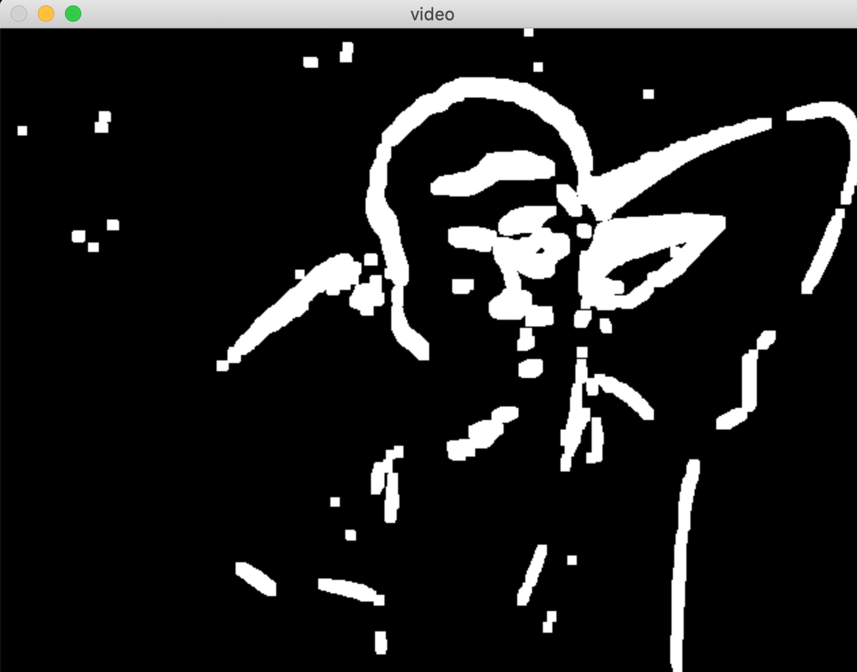
Image flow
No motion
Motion detected
Gray image
Blurring
Setting up threshold value
Alarm
Big contours
Motion detected
Small contours
Dilated image

Slide 5
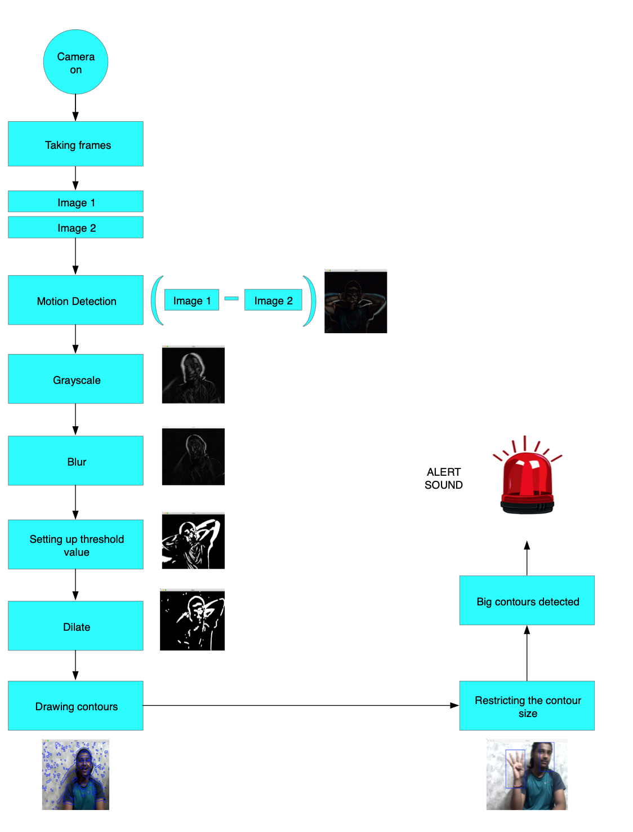
Our Model

Slide 6
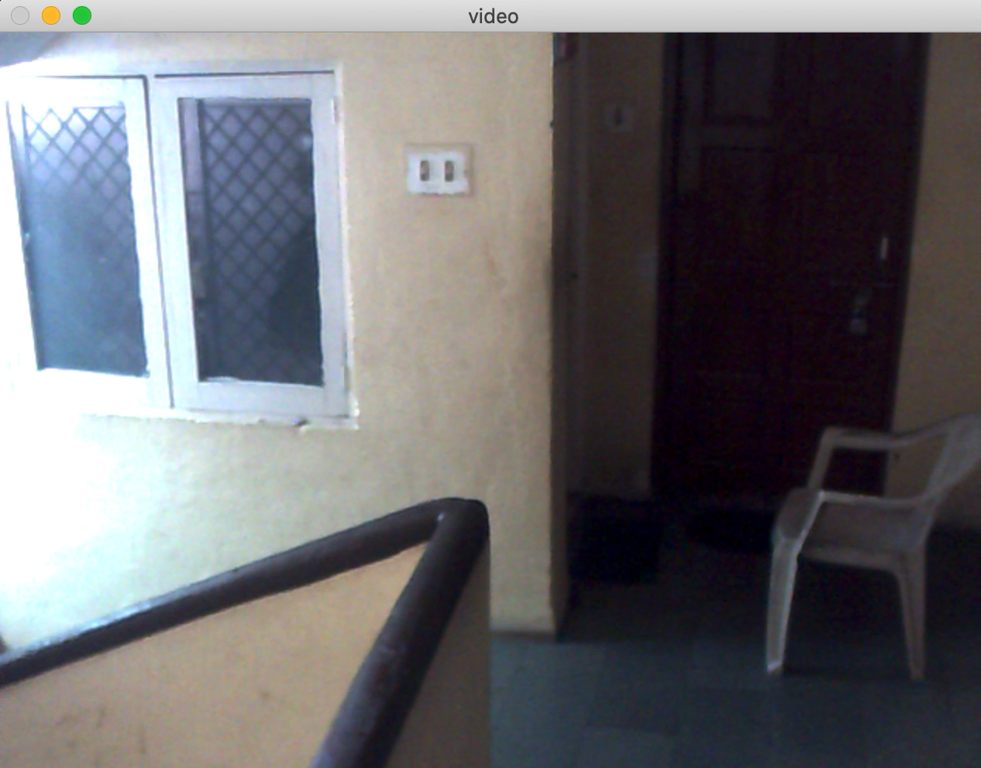
Output
As soon as the big contours are detected the alert sound starts buzzing.

Slide 7
Thank You

